Slide 1
Representing Youth in Immigration Proceedings
Ashley Melwani
Senior Staff Attorney
Pro Bono Director
Jessica Lora
Social Worker

Slide 2
Topics of today’s training
Background on LSC and our Pro Bono Project
Overview of youth in the immigration system
Accompanied vs. unaccompanied
In removal proceedings vs. affirmative applicants
Detained vs. non-detained
Forms of immigration relief available to youth
Emphasis on SIJS and asylum
LSC’s Holistic Model
Working with trauma-affected youth

Slide 3
Legal Services for Children
Free legal and social work services for youth in guardianships, dependency, school discipline, infraction defense, and immigration
We initiate cases for youth up to the age of 21 in the San Francisco Bay Area and ORR facilities in Northern California
Holistic model
Direct representation and Pro Bono Project
Notes:
Who is LSC:
Education: youth having issues with enrollment, suspensions, or expulsions.
Guardianship: youth who are unable to live with parent(s) and want another adult to be appointed as legal guardian.
Dependency: youth who are in the foster care system
Immigration: undocumented youth eligible for special kinds of visas or DACA (detained and non-detained)
Infraction defense – homeless youth

Slide 4
Pro Bono Project
Training – In person and web-based
Mentorship — Mentor Attorney, Attorney of the Day, ILRC, and CGRS
Resources – Online Resource Library
Support — LSC social worker involvement
Time — Accept a case when it fits your schedule. Full scope representation vs. discreet projects
Notes:
See 2-page overview of PB program

Slide 5
Immigration 101 - Terminology
Undocumented – a person who does not have legal permission to be in the United States
Documented – a person who has legal permission to be in the United States. Could be for a period of time or indefinitely.
Lawful Permanent Resident – a person who has permission to live and work in the United States indefinitely, assuming they do not commit certain crimes or leave the country for long periods of time.
ICE – Immigration and Customs Enforcement – Federal agency responsible for immigration enforcement. Can detain and deport/remove immigrants.
USCIS – U.S. Citizenship and Immigration Services – handles affirmative applications for immigration benefits and relief.
ORR – Office of Refugee Resettlement – Federal agency responsible for the custody of unaccompanied alien minors.
Notes:
Undocumented includes children who:
-were brought to US on a visa that expired
-entered the US w/o inspection
-obtained lawful status and subsequently lost it

Slide 6
Two groups of immigrant youth
Accompanied – youth who are living with a parent or guardian in the United States
Unaccompanied – youth who have immigrated to the United States alone or who do not have a parent or legal guardian in the United States to care for them
Unaccompanied Alien Child (UAC) – 6 USC § 279(g)(2)
Has no lawful immigration status in the U.S.;
Has not attained 18 years of age;
And: (1) no parent or legal guardian in the U.S.; or (2) no parent or legal guardian in the U.S. is available to provide care and physical custody.
Notes:
-Accompanied – include many DACA clients
-Unaccompanied - certain benefits that come w/ being designated a UAC – ex: apply affirmatively for asylum even if in removal proceedings
-Can go from one status to the other – through de-designation or through being separated from parent (zero-tolerance, deportation, etc.)

Slide 7
Quiz – True or False?
Illegal immigration to the United States is at an all time high since 2000.

Slide 8
ANSWER: FALSE

Slide 9
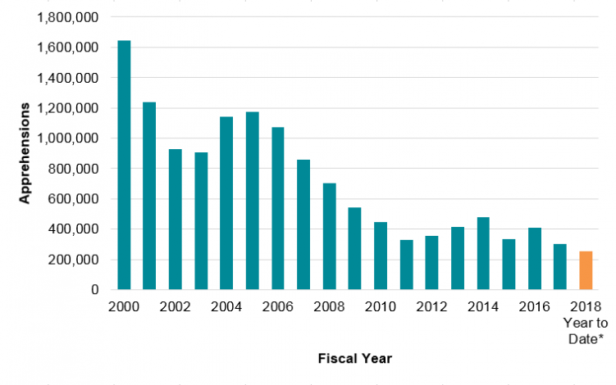
Migration crisis?
https://www.migrationpolicy.org/news/crisis-border-not-numbers
Notes:
-Illegal border crossings have been falling steadily since 2000 (esp from Mexico); dips during each recession
-Reasons for migration changing – less driven by economics and family reunification, more safety driven
-Despite border patrol agents almost doubling since 2000

Slide 10
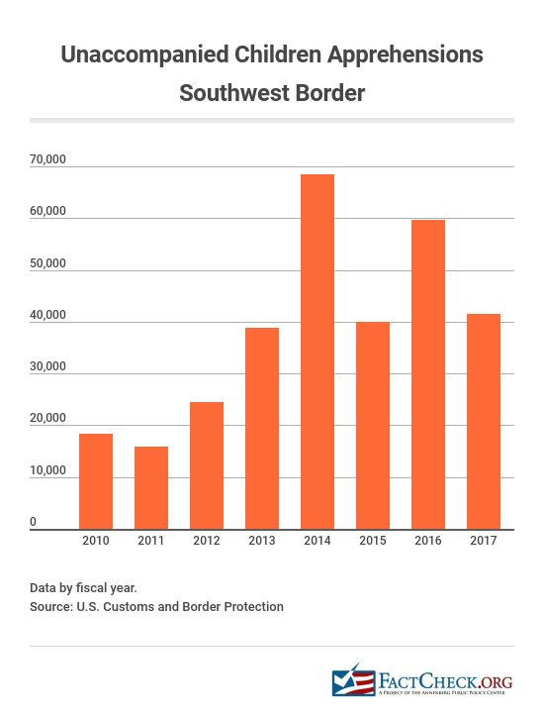
Notes:
2018 – currently up 17% from last year

Slide 11
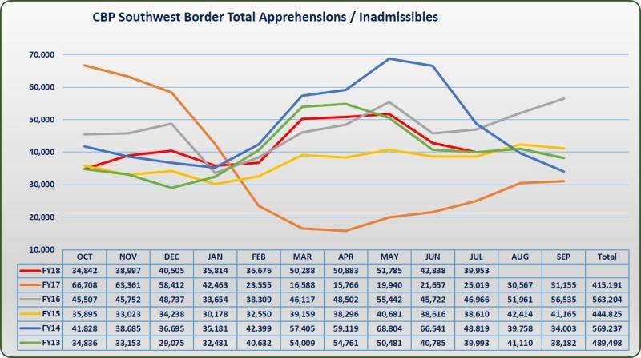
Does deterrence work?
Source: https://www.cbp.gov/newsroom/stats/sw-border-migration
Notes:
-Illegal border crossings have been falling steadily since 2000 (esp from Mexico); dips during each recession
-Reasons for migration changing – less driven by economics and family reunification, more safety driven
July saw a decline of nearly 7 percent overall compared to June 2018.
The largest decrease of nearly 23 percent stemmed from UAC apprehended between ports of entry.
Family Units remained nearly flat with an overall less than 1 percent decline.
Comparing July 2018 to July 2017, the overall numbers are up nearly 57 percent with the largest increase being Family Units which increased more than 142 percent year over year.
For the Fiscal Year to Date FYTD 2018 compared to FYTD 2017 the numbers are up 16 percent for UAC, 29 percent for Family Units and overall the numbers are up almost 20 percent compared to this time last year.
Research shows hard to deter people when fleeing for safety reasons, but may change the route of migration and may make more vulnerable to trafficking/exploitation
Source: CBP.gov

Slide 12
Who are our clients?
Notes:
La bestia
Hieleras

Slide 13
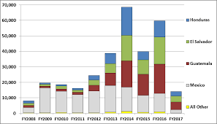
Where are they coming from?
Source: “Unaccompanied Alien Children: An Overview” by William A. Kandel, Congressional Research Service, Jan. 18, 2017, at https://fas.org/sgp/crs/homesec/R43599.pdf.
Notes:
2017 – only shoes data from first two months (ended up exceeding 2015 numbers)
2018 – currently up 17% from last year

Slide 14
Source: “Children on the Run,” UNHCR, 2014, at http://www.unhcr.org/en-us/children-on-the-run.html
Notes:
Unaccompanied immigrant and refugee children are primarily driven to the U.S. by brutal and pervasive violence and human trafficking in the Northern Triangle. Their countries of origin match the overall migration trend of increased immigration from Central America, as immigration from Mexico decreases. • El Salvador, Honduras, and Guatemala are among the most violent countries in the world.
• Honduras is the most murderous country in the world, with a murder rate of 91.6 murders per 100,000 inhabitants.
• El Salvador is the next deadliest country with 69.2 murders per 100,000 inhabitants.
• Guatemala has the sixth highest murder rate at 38.5 murders per 100,000 inhabitants.
• El Salvador and Guatemala have the world’s highest homicide rates among children and adolescents.
• More than half of those killed in El Salvador, Honduras, and Guatemala in 2015 were under 30 years of age.
• El Salvador, Guatemala, and Honduras rank first, third, and seventh, respectively, for rates of female homicides globally
• More than two-thirds (69%) of victims of sexual and gender-based violence tried to find safety by fleeing elsewhere in their own country, but they continued to experience similar levels of violence even in new locations.
• According to U.S. government statistics, 82% of 16,077 women from El Salvador, Honduras, and Guatemala, countries who were interviewed by U.S. authorities were found to have a credible fear of persecution or torture and were allowed to pursue their claims for asylum in the United States
Source: KIND Briefing Book, 2018, citing World Atlas, Murder Rate by Country, https://www.worldatlas.com/articles/murder-rates-by-country.html.

Slide 15
Why are children coming?
Fleeing extreme levels of violence in home country
Escaping abuse, neglect, abandonment
Reunifying with parents or other family members in U.S.
Seeking improved educational and economic opportunities
Notes:
http://www.immigrationpolicy.org/sites/default/files/docs/children_in_danger_a_guide_to_the_humanitarian_challenge_at_the_border_final.pdf
http://www.unhcrwashington.org/sites/default/files/1_UAC_Children%20on%20the%20Run_Full%20Report.pdf
http://www.womensrefugeecommission.org/programs/migrant-rights/unaccompanied-children

Slide 16
How are children apprehended?
Border Apprehension – children caught by CBP while crossing the border
May be first time recent arrivals – these are the majority of the unaccompanied children we see in removal proceedings
May be repeat crossers such as children working as drug mules or foot guides
Internal Apprehension – juvenile justice-involved children referred to ICE by probation
May have lived in the US for many years and have mixed status families
Notes:
Internal Apprehension – may also be children who were originally detained at border, referred to ORR custody and then released to a sponsor. The child may have run away from the sponsor’s home because the sponsor was abusive or neglectful – maybe even trafficked the child. The child becomes homeless and then jj involved.

Slide 17
Quiz – True or False?
Once Immigration and Customs Enforcement (ICE) apprehends a youth,
the youth will be deported from the United States and cannot legally re-enter.

Slide 18
ANSWER: FALSE

Slide 19
Referrals to the Office of Refugee Resettlement (ORR)
If a UAC is detained by immigration, they will be transferred to the custody of the Office of Refugee Resettlement (ORR) within 72 hours.
ORR is within the Administration of Children and Families (ACF) under the Department of Health and Human Services (HHS).
Homeland Security Act of 2002; 8 U.S.C. § 1232(b)(1)
The minor can be placed in ORR custody anywhere in the country.
Several different levels of detention:
Shelter (lowest level) – one in Contra Costa County
Staff Secure (high staff ratio, group homes) – one in Solano County
Secure (juvenile halls: only three in the country) – one in Yolo County
Notes:
http://www.acf.hhs.gov/programs/orr/programs/ucs

Slide 20
Reunification and Release Process
Children detained in ORR custody have the right to be released to a qualified sponsor while their immigration cases are pending
Ideally, ORR works on releasing children in a timely and safe manner to an eligible sponsor
If no sponsor, there is the possibility of the youth going into federal foster care, specifically for unaccompanied immigrant youth.
Flores Settlement Agreement: https://www.aclu.org/files/pdfs/immigrants/flores_v_meese_agreement.pdf
Notes:
-Challenges with sponsors being fearful
-If no sponsor, may end up in LTFC – we have a program in Solano County
-Stipulated Settlement Agreement ¶ 14, Flores v. Reno, No. 85-cv-4544 (C.D. Cal. 1997), [hereinafter “Flores Agreement”], https://www.aclu.org/files/pdfs/immigrants/flores_v_meese_agreement.pdf.

Slide 21
Challenges facing youth in detention
Additional challenges facing youth in prolonged detention:
Rapid deterioration of mental health
Untreated/undertreated trauma
PTSD, anxiety, depression
Detention can mimic past trauma
Hopelessness
Detention fatigue
Loss of educational opportunities
Risk of aging out of certain protections
Logistical challenges of getting representation > see FAQs about LSC’s Pro Bono Detained Cases
Notes:
Most youth have experienced trauma – AAN, witnessed extreme violence, even tortured
No adequate mental health services in ORR (language issues, confidentiality issues)
Ageing out > may lose SIJ eligibility, may go to ICE custody and then have to seek bond

Slide 22
Benefits of immediate advocacy for detained youth
Mental health – there is hope!
Increased chance of step-down or release
If aging out – increased chance of ICE discretion
If aged out – better bond outcomes
Immigration relief

Slide 23
Challenges facing all undocumented youth
Cannot work legally or get Social Security Number;
Cannot get state ID (except AB60);
Cannot receive federal financial aid for college;
Not eligible for most public benefits (minors can still get emergency MediCal or Healthy Families in SF)
Unable to travel
Face risk of deportation for lack of status; and
Many undocumented youth experience feelings of exclusion, instability, and constant fear of deportation.
Notes:
AB540 – allows undoc youth in CA to pay same tuition as any in-state resident (if attended 3 yrs HS in CA and graduated)
To receive federal financial aid, a youth must either be a U.S. Citizen or a green card holder, refugee, asylee or parolee or an abused spouse or child of a U.S. citizen or green card holder with a pending or approved immigration application.
To be eligible for public benefits including SSI, Food Stamps, CalWorks/TANF and Medi-Cal/Medicaid/Healthy Families, people must generally be:
A U.S. Citizen
A victim of trafficking
A lawful permanent resident
a refugee or asylee
A Cuban or Haitian
Or a victim of domestic violence with a pending immigration application
A U visa applicant or U visa holder
Cash Assistance Program for Immigrants (CAPI) – must have qualifying disability (like SSI but for non qualifying immigrants)
With SB 4 which went into effect in May 2016, Undocumented youth under 19 may also be eligible for MediCal
More information at www.NILC.org/wp-content/uploads/2015/11/tbl1_ovrvw-fed-pgms.pdf

Slide 24
Immigration Court
ICE apprehension is not an automatic path to deportation–
ICE Processing
Referral to Immigration Court (Notice to Appear)
If eligible for any kind of legal status, they can apply for that status and if it is granted, their immigration case may be closed.
Master Calendar Hearings vs. Individual Hearings
Pro Bono attorneys will most likely be seeking continuances of immigration court proceedings, and eventually termination of those proceedings
No right to an attorney in immigration court
Is it necessary? https://www.youtube.com/watch?v=BN9t7LUf6RQ

Slide 25
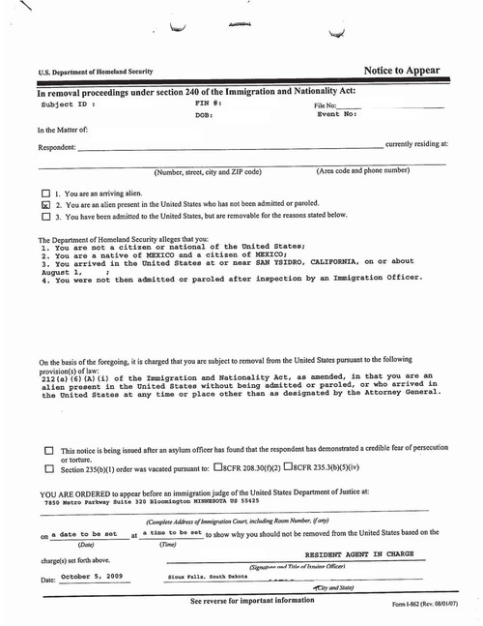
NTA
Government’s burden of proof – clear and convincing evidence
Pleadings – admit allegations? Concede removability?
Challenge service?
Pereira v. Sessions – may have grounds for a motion to terminate (or re-open and terminate if prior removal order
Motions to suppress
Notes:
Pereira – US Supreme Court held that NTAs that don’t designate an actual time and place to appear are deficient. Possible grounds for a motion to re-open and/or terminate.

Slide 26
Deportation/Removal
If a minor does not have relief and does not qualify for voluntary departure, he or she may be removed (deported).
If a minor doesn't appear for that scheduled hearing, the Immigration Judge can order his or her deportation in absentia if the DHS (ICE) clearly proves that the minor was inadmissible and was served the Notice to Appear.
Once a removal order is entered, a minor will be ineligible for most discretionary relief from removal for 10 years.
Voluntary departure is a discretionary benefit of limited value
- Sought when client wishes to repatriate, or has no other choice

Slide 27
Quiz – True or False?
If you want to immigrate to the United States legally from outside of the United States, you may apply and your application will be processed in a timely manner.

Slide 28
ANSWER:
DEPENDS, BUT VERY RARELY TRUE.

Slide 29
Potential Options
Non-immigrant visas (ex: tourist, student, work): require resources or education in home country.
Immigrant visas (ex: family-based, employment based): require an immediate relative USC or LPR / require degree and being outstanding in your field; preference system. Generally require lawful admission and maintaining lawful status. Otherwise must show extreme hardship and attend a consular interview abroad.
Asylum and refugee status: asylum may not be sought abroad; refugees limited by country and numerical cap.
Temporary and limited relief (ex: DACA, TPS): provide work permit and reprieve from deportation, but are always at risk of ending.
Other forms of humanitarian relief (ex: SIJS, T Visas, U Visas): cannot be sought from abroad.
Notes:
Forms of non-immigrant visas
Common examples:
Tourist Visa
Student Visa
Work Visa – H1B (skilled worker); L (intra-company transferee), etc.
Advantages
Don’t need a family member who is already a permanent resident or U.S. Citizen
Disadvantages
Need resources or education in home country: For tourist visa, have to show willing to return. For student visa, have to show have financial resources to study without working or financial aid. For work visa, need offer of employment and at least a Bachelor’s degree.
Forms of immigrant visas (can lead to residency)
Common examples
Family Based
Immediate Relatives: Spouse, parent, or child of U.S. Citizen (child = unmarried and under 21)
Preference system: adult or married son or daughter or sibling of U.S. Citizen; spouse or unmarried adult son or daughter of lawful permanent resident.
Employment based:
Need degree and often also need to be outstanding in your field.
Advantages
These are the most common ways that people immigrate to the U.S.
Disadvantages
Generally, have to have entered lawfully and maintained status. If did not enter lawfully, most likely have to show spouse or parent will suffer extreme hardship and attend interview at U.S. consulate abroad. Also, need the requisite family relationship or access to the required education and training.
Asylee and refugee status:
Refugees are processed from abroad – only certain countries and a numerical cap each year (Trump has slashed resettlement number and made much more difficult for some countries). Can apply for permanent residence a year after entry.
Have to apply for asylum from within the U.S. (or at port of entry). Put in removal proceedings if denied.
Well-founded fear of persecution on account of your race, religion, nationality, political opinion, or membership in a particular social group.
Special protections for unaccompanied minors: can apply to USCIS and have non-adversarial interview even if in removal proceedings.
Temporary and limited relief
Common examples (DACA, TPS)
Advantages
Work permit and ability to stay in U.S.
Disadvantages
Temporary nature and current administration trying to terminate DACA and trying to terminate TPS for most countries.
Otherwise > undocumented

Slide 30
Immigration Options for Youth
SIJS
Asylum
T Visa
U Visa
DACA
VAWA
Family Based Visas
Cancellation of Removal

Slide 31
Special Immigrant Juvenile Status (SIJS) Background
Created by statute in 1990 to provide a path to lawful permanent residency for certain vulnerable children
Amended multiple times, most notably by the William Wilberforce Trafficking Victims Protection Act (TVPRA) of 2008 – broadened by adding the “one or both parent” language

Slide 32
Special Immigrant Juvenile Status (SIJS) Eligibility Requirements
1) Is under twenty-one years of age;
2) Is unmarried;
3) Has been declared dependent upon a juvenile court located in the United States or whom such a court has legally committed to or placed under the custody or an agency or department of a State, or an individual or entity appointed by a State or juvenile court located in the United States.
4) Whose reunification with one or both of the immigrant’s parents is not viable due to abuse, neglect or abandonment, or a similar basis found under State law.
5) For whom it has been determined in an administrative or judicial proceeding that it would not be in the alien’s best interest to be returned to the alien’s or parent’s previous country of nationality or country of last habitual residence.
8 U.S.C. § 1101(a)(27)(J)
Notes:
Most of our cases
What is a juvenile court?
Probate/ guardianship
Dependency/ foster care
Delinquency
Family court
This court is making the findings, including BI findings.
Examples of abuse
Physical abuse
Exposure to DV between parents
Neglect in home country
Work early age/ no school
Benefits – work authorization, immediately able to adjust to LPR

Slide 33
SIJS Continued - Dependent on a Juvenile Court
The term “juvenile court” is a court located in the United States having jurisdiction under State law to make judicial determinations about the custody and care of juveniles.
In California this includes dependency, delinquency or probate guardianships, and family court custody determinations
Age-limitations (under 21 for immigration purposes; under 18 for delinquency and family court; probate court – currently complicated)
This requirement makes SIJS inaccessible to clients in ORR custody in California
Notes:
-As the companies subcontracted by ORR are incorporated outside of California, the State juvenile courts do not have jurisdiction over them-Hoping for legislative fix in the next year

Slide 34
SIJS Continued - Reunification not Viable
A juvenile court must make a determination that reunification with one or both of the minor’s parents is not viable due to abuse, neglect, abandonment or similar basis under state law.
Examples:
Abuse: Physical, emotionally, verbal by parents or caretaker
Neglect:
Substantial risk of serious physical harm or illness
Not providing for basic needs
Forced to work full-time and not attend school
Subjected to dangerous conditions/journey (or unable to protect)
Abandonment:
Parent left child
Parent is deceased
Other similar basis in state law: similar to above
Notes:
“One or both” – but play it safe and allege both if facts support it
See Welfare & Institutions Code, Family Code, Penal Code

Slide 35
SIJS Continued – Best Interests
A court determines that it is in the young person’s best interests to stay in the U.S., as opposed to return to herhome country.
Examples of relevant factors:
Positive (in the US)
Family/friend support system
Emotional well-being
Medical and educational resources
Negative (in home country)
Lack of appropriate caretaker
Lack of educational opportunities
Violence

Slide 36
SIJS Continued – Multi-Step Process Step 1 – State Court
Minor must come within a juvenile court’s jurisdiction
In LSC pro bono cases, this is almost always through a guardianship proceeding in probate court (often the ORR sponsor is the proposed guardian)
Obtain “predicate order” establishing SIJ eligibility
California has judicial council forms for the petition (JV-356; FL-356; GC-220) and the predicate order (JV-357; FL-357; GC-224)
Maintain juvenile court jurisdiction until child has permanent residency if possible (or until they age out) – Perez Olano
Notes:
Most unaccompanied kids have been released to a sponsor who can serve as legal guardian

Slide 37
SIJS Continued – Step 1 (cont’d) Probate Court: What is a Legal Guardianship?
Suspends parents’ rights to custody of their child
Does NOT permanently terminate parental rights
Places custody with another adult
Right and responsibility to make almost all decisions affecting the care and supervision of that minor
Determine the minor's domicile
Provide consent for the minor's medical care
Guide the minor's educational development
Guide the minor’s religious development
Make any reasonable order to control the minor's conduct
Note: guardian’s powers are much more limited in AB900 (over-18) cases
Notes:
Parents remain financially responsible (technically)
Can be terminated at any time

Slide 38
SIJS Continued – Step 1 (cont’d) Probate Court
Minor must be over 12 to petition for guardianship
Guardianship must be necessary or convenient; if contested, standard shifts to best interest of the child
Process involves filing Judicial Council forms, providing notice, a home visit by the Court Investigator, and a brief hearing
LSC resources for guardianship and SIJ cases:
Webinar trainings
Guardianship Manual
Appendix of sample forms
Additional guidance
See our online Resource Library
Notes:
Most unaccompanied kids have been released to a sponsor who can serve as legal guardian

Slide 39
SIJS Continued – Step 2 – Immigration Stage
Submitting SIJ (Form I-360) application to USCIS with SIJ predicate order
Waiting for client’s “priority date” to become current (visa cap)
Terminating removal proceedings (if applicable)
Submitting green card application (Form I-485) and work permit application (I-765)
Evolving process
Previously required an interview; now usually none
USCIS has consolidated review of these cases
May receive a Request for Evidence (RFE) or Notice of Intent to Deny (NOID)
Recent denials of AB900 (over-18) cases
Potential risk of applying affirmatively > will be referred to ICE for prosecution if application is denied.
Notes:
-AB 900 (Cal Prob Code 1510.1), 2015 – Cal attempt to correct misalignment between state and fed law (INA defines child up to 21)
-J.L. v. Cissna – class action re AB 900 cases - seeking preliminary injunction (hearing 10/17/18)
Risks in affirmative cases:
-6/28/18 memo: will refer all denied petitions to ICE for NTA
-As of 9/11/18 – USCIS can deny SIJ petitions for lack of evidence w/o issuing RFE or NOID
-New incentive to pursue additional forms of relief (asylum)

Slide 40
SIJS Continued – Benefits of obtaining SIJS
Client immediately eligible to apply for adjustment of status to become a permanent resident (but often subject to visa cap); citizenship eligibility five years later
Once client becomes a lawful permanent resident they are:
Eligible for Social Security Number
Able to work legally
Able to travel outside of the United States (including to home country)
Able to obtain a regular driver’s license
Eligible for FAFSA
Eligible for public benefits
May petition for relatives once LPR, but never either parent

Slide 41
Asylum
Must be a victim of past persecution or have a well-founded fear of future persecution based on race, religion, political opinion, nationality or membership in a particular social group INA § 101(a)(42)(A)
Persecution must be by government or group the government is unwilling or unable to control
Cannot relocate
Note: One-year filing deadline (after entering the U.S., though time before 18 doesn’t all count, and the bar doesn’t apply to unaccompanied children)
TVPRA § 235(d)(7)(A)

Slide 42
Asylum (continued)
Unaccompanied children may apply affirmatively with USCIS even if in removal proceedings – huge benefit
Process:
Submit Form I-589 application for asylum to San Francisco Asylum Office (part of USCIS)
Wait for an interview
Prior to interview, submit declaration, supporting evidence, country conditions research, and any psychological evaluation
If denied > referred to immigration court

Slide 43
Asylum (continued)
Rapidly evolving policies and case law
First In, First Out
Gang-based cases
Domestic violence and child abuse cases
Matter of A-B-, 27 I&N Dec. 316 (A.G. 2018)
Challenging, but there is hope!
LSC and the pro bono attorneys we partner with have access to a wealth of resources in these cases through the Center for Gender and Refugee Studies (CGRS) at UC Hastings
Notes:
AG Sessions invoked rarely utilized power to certify the BIA case to himself and reverse the Board’s decision to grant asylum to Salvadoran woman fleeing horrific DV; remanded to immigration court; will likely be appealed to 4th Cir

Slide 44
Asylum (continued) Benefits
Eligible to apply for a work permit after application pending for 150 days
Eligible to apply for adjustment of status (green card) after one year of asylum status, and citizenship four years after that
Cash and medical benefits for first eight months of asylee status
Job training and counseling
May include spouse and unmarried children under 21 as derivatives on asylum application; may also petition for parents and siblings after adjustment
Note: should not travel back to home country until becoming a U.S. citizen
Notes:
AG Sessions invoked rarely utilized power to certify the BIA case to himself and reverse the Board’s decision to grant asylum to Salvadoran woman fleeing horrific DV; remanded to immigration court; will likely be appealed to 4th Cir

Slide 45
T (trafficking) Visa
Victim of sex trafficking or labor trafficking
Sex trafficking: a commercial sex act is induced by force, fraud or coercion or in which the person has not yet obtained 18 years of age.
Labor trafficking: the recruitment, harboring, transportation, provision or obtaining of a person for labor or services through the use of force, fraud, or coercion for the purpose of subjection to involuntary servitude or debt bondage
Physical presence in the U.S. is on account of trafficking
Notes:
Most children won’t self-identify as trafficking victims – it’s a fact based determination
Did the child have to work?
Was there force, fraud or coercion?
T Visa: Victim of human trafficking (sex or labor trafficking), physical presence on account of the trafficking activity, and would suffer extreme hardship involving unusual and severe harm upon removal
In applying for a T visa, it is helpful, but not required for minors, to file certification from law enforcement (similar to the U visa certification) –
http://www.uscis.gov/sites/default/files/files/form/i-914supb.pdf
Child trafficking victims are eligible for additional benefits from the federal government
See http://www.acf.hhs.gov/programs/orr/resource/child-trafficking
T: ex: drug trafficking To qualify, you need to have come to the U.S. by force, under threats, persecution, or under duress, to work or do something against your will or if you have been forced into terrible working conditions once you were in the U.S.
T Visa: Victim of human trafficking (sex or labor trafficking), physical presence on account of the trafficking activity, and would suffer extreme hardship involving unusual and severe harm upon removal

Slide 46
U Visa (victim of crime)
Suffered substantial physical or mental abuse as a result of having been a victim of certain serious crimes which took place in the United States
Possesses information concerning the crime and helpful in the investigation or prosecution
Must report crime to law enforcement and follow up on requests for help in the investigation or prosecution
Process involves obtaining a certification from law enforcement and filing forms with USCIS
Notes:
Crimes: rape; torture; trafficking; incest; domestic violence; sexual assault; abusive sexual contact; prostitution; sexual exploitation; female genital mutilation; being held hostage; peonage; involuntary servitude; slave trade; kidnapping; abduction; unlawful criminal restraint; false imprisonment; blackmail; extortion; manslaughter; murder; felonious assault; witness tampering; obstruction of justice; perjury; or attempt, conspiracy, or solicitation to commit any of the above mentioned crimes

Slide 47
Deferred Action for Childhood Arrivals (DACA)
Created by the Obama administration in June 2012, DACA allows certain undocumented immigrants who entered the U.S. as minors to receive a renewable two year deferred action from immigration proceedings (deportation) and a work permit
Requirements include continuous presence in the U.S. since June 2007
No pathway to legal permanent residency/citizenship

Slide 48
Violence Against Woman Act (VAWA)
Victim of abuse by parent or step parent or child of victim of domestic violence by spouse
Abuser is a lawful permanent resident or U.S. citizen

Slide 49
Family-Based Visas
US Citizens and Lawful Permanent Residents can apply for different family members to immigrate legally
US Citizens can apply for:
Immediate family members: spouse, unmarried child under 21 (including stepchild), parent (if petitioner is over 21)
Unmarried son or daughter (1st pref), married son or daughter (3rd pref), brother or sister (4th pref)
Lawful Permanent Residents can apply for:
Spouse and unmarried sons or daughters (2nd pref)
Notes:
Depending on which preference category, could be a long waiting list
Depending on method of entry may have to return to home country and consular process
Adoption:
U.S. citizen or lawful permanent resident can petition for adopted child if adoption finalized before child was 16 and child has been in legal custody for two years

Slide 50
Cancellation of Removal
An undocumented immigrant who is in removal proceedings may apply for cancellation of removal if:
(1) he has been physically present in the United States for ten years preceding the date of the request;
(2) he has been a person of good moral character during those ten years (e.g., no criminal/immigration record)
(3) he has not been convicted of certain offenses
(4) that removal would result in exceptional and extremely unusual hardship to the alien's spouse, parent, or child who is a citizen of the United States or a lawful permanent resident

Slide 51
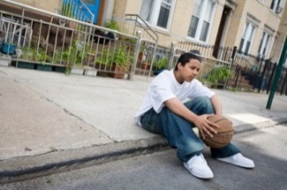
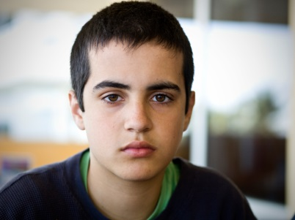
Holistic Model: Social Work Support
Notes:
-LSC social workers provide additional support to youth and their families (non-legal needs)
-PB cases have a SW assigned
- when PB is assigned, SW likely has already met the family and started/completed a comprehensive assessment

Slide 52
Social Worker Roles
Legal needs: attending court hearings to support the youth
(immigration, guardianship, delinquency,
dependency, etc.)
Non-legal needs:
- Education
- Health
- Referrals to community resources
Notes:
-SW can attend legal meetings if clt requests
-PB should inform SW of any needs that come up

Slide 53
Social Workers are NOT:
Translators
Primary schedulers/messengers
Agents of the attorney (have duty to report)
Notes:
-Most, but not all, immigration clients have limited English proficiency
-PB’s should provide interpreter whenever possible, especially since SW may not always be available to meet when PB and Clt meet
-SW can assist with arranging initial meeting
-if clt is unresponsive, SW can assist PB in contacting clt
-explain mandated reporting

Slide 54
Tips for Working with Youth
Building Rapport
Trauma-Informed Practice

Slide 55
Building Rapport
It takes time to build trust and become familiar with the attorney and interview setting
Take time to get to know your client
Be friendly and relaxed
Talk about hobbies, likes, dislikes, etc.
Notes:
-Building a relationship with clients is fundamental for effective delivery of services
-Rapport: confidence, cooperation, acceptance, understanding, respect, comfortable/safe atmosphere

Slide 56
Trauma-Informed Practice
Clients should be informed
Purpose of the interview
Role of the interviewer
Length of relationship
Notes:
-As the attorney, it is important that you obtain as much info as possible for the client’s case. However, keep in mind your clients’ experiences and how these have affected their behaviors and willingness to disclose information

Slide 57
Trauma-Informed Practice
Have a conversation, not an interrogation
“sprinkle” questions throughout the conversation
Elicit a free narrative
Let client use his/her own words instead of suggesting answers
Open-ended questions
“A few minutes ago you told me that Robert hurt you. How did Robert hurt you?”
Notes:
-As the attorney, it is important that you obtain as much info as possible for the client’s case. However, keep in mind your clients’ experiences and how these have affected their behaviors and willingness to disclose information

Slide 58
Recalling Traumatic Experiences
Preface difficult questions
“I’m going to ask you something more personal/difficult/etc.
Be aware of nonverbal cues
How is the client reacting during interview?
Check in with the client and take breaks as needed
Notes:
It’s important to acknowledge the client’s trauma
Nonverbal cues
-anxiety
-change of tone or expression
-fidgeting

Slide 59
Things to Avoid
Rushing your client to answer questions
Questions beginning with “Why”
Can be interpreted as attributing blame to the client
Suggesting answers to your question
Allow client to explain in own words
“Tell me what you remember about…”
Notes:
Don’t rush your client
-They need time to understand/ think about questions/ retrieve info from their memory/ put info into words/ find a way to communicate their response
Don’t suggest answers
-sometimes children will confirm when given answers; they think they’re saying what you want to hear

Slide 60
Additional things to keep in mind
First time working with a lawyer
Legal matters can feel overwhelming
Visiting a law office can be intimidating
Legal jargon is confusing
- use language that non-lawyers will understand
- written communication should be in youth’s preferred language
Notes:
Communication
-email example
-written comm in Spanish to the extent possible

Slide 61
Next Step
Join our Pro Bono panel to begin receiving periodic emails with case and project opportunities!
https://www.lsc-sf.org/get-involved/pro-bono-panel/

Slide 62
Questions?

